Slide 1
Tanzanian Water Well Crisis: A Predictive Model
By: Jeffrey Ng

Slide 2
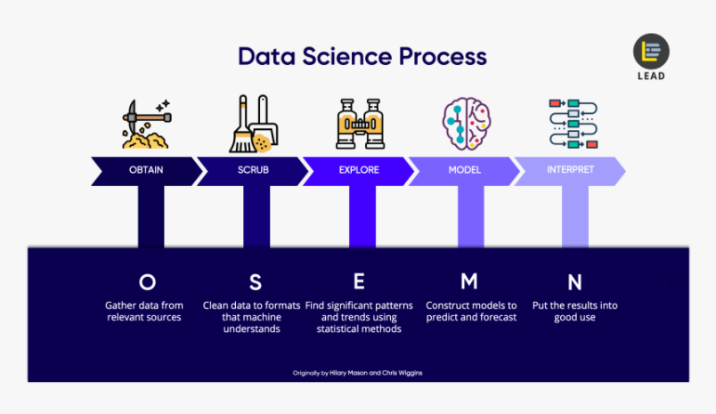

Slide 3
OBTAIN AND SCRUB
DATASET OF 59,400 OBSERVATION POINTS FROM DRIVENDATA.ORG, PUMP IT UP: DATA MINING THE WATER TABLE OF WATER CRISIS IN TANZANIA
MAINLY CATEGORICAL DATA
TERNARY CLASSIFICATION PROBLEM WHERE TARGET VARIABLE IS ‘STATUS GROUP’
WE WANT TO PREDICT IF THE WELL FALLS INTO THE 3 CLASSES: ‘FUNCTIONAL’, ‘NEEDS REPAIR’, AND ‘NON FUNCTIONAL’

Slide 4
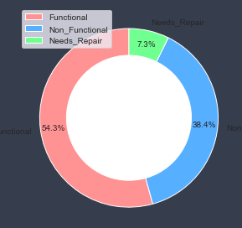
EDA (The problem)
59,400 WATER WELLS IN TANZANIA
46% NEED MAINTENANCE
PAYMENT HAD GOOD CORRELATION TO WELL FUNCTIONALITY
DRY & UNPOTABLE WELLS HAD SLIGHT NEGATIVE CORRELATION WITH FUNCTIONALITY

Slide 5
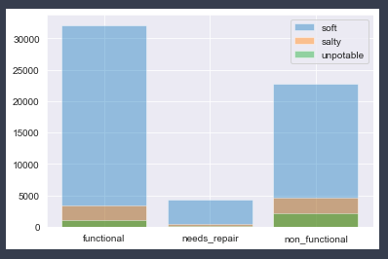
The Problem - Potability vs Functionality
Key Points:
Still about 21,500 wells have potable water in need of maintenance
Unpotable water were: milky, colored, or flouride abandoned
9.7% of wells have unpotable water

Slide 6
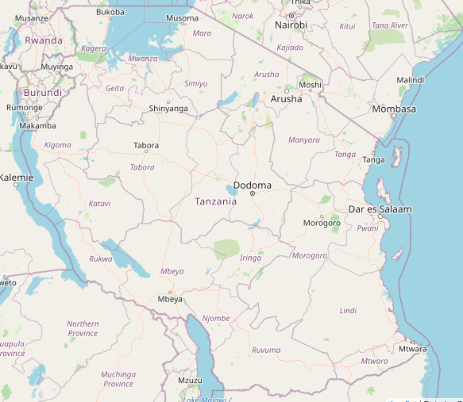
EDA (The problem- deeper analysis)
20% of wells have less than optimum water
9.7% of wells have unpotable water
Age of wells before breakdown is 18-20 years
Hardest hit regions are Mbeya, Morogoro, Shinyanga, Kilaminjaro, Kagera

Slide 7
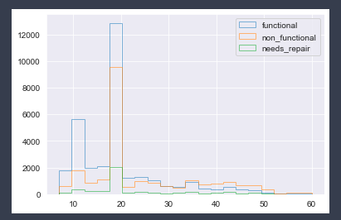
The problem - Age and Maintenance
Key Points:
At 20 years old wells start needing maintenance
With the amt of wells built in 2000, right now is the time to start addressing major repair plans

Slide 8
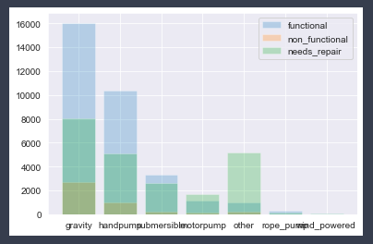
The Problem - Mechanism of Wells and Functionality
Key Points:
Submersible, motor pump and other need the most maintenance
About 26,000 wells are not mechanized

Slide 9
Predictive Models
Strategy: To use RFECV to narrow down our features (93 to 47) and then fit our data thru different models with the features. Models tested included: ✓
Ridge Classifier
Bagging w/ Ridge Classifier
Random Forest ✓
Extra Trees
XGBoost w/ Gridsearch ✓
Decision Tree
K-Nearest Neighbors
Voting Classifier w/ knn, dtc, rfc, bagging
Bagging w/ rfc
AdaBoost w/ rfc
Gradient Boosting

Slide 10
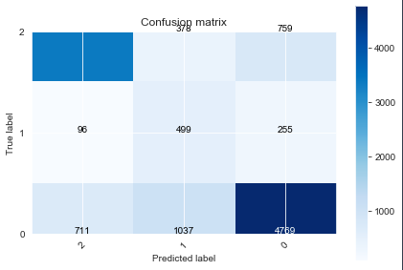
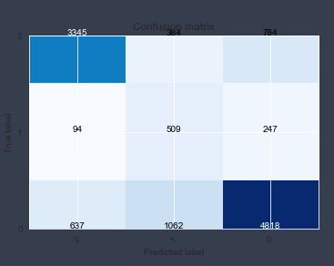
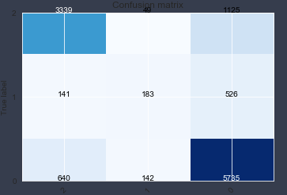
Top 3 Models (Interpret)
I used ‘Precision’ as my most important evaluation metric to minimize false positives (the prediction of a well to be functional when it is not). Accuracy is also important.
378 750 = 1128
384 784 = 1168
49 1125 = 1174
3376
Random Forest w/ RFECV
Accuracy : 0.730
Precision: 0.780
Random Forest
Accuracy: .730
Precision: .782
XGBoost w/ GridSCV
Accuracy: .781
Precision: .771

Slide 11
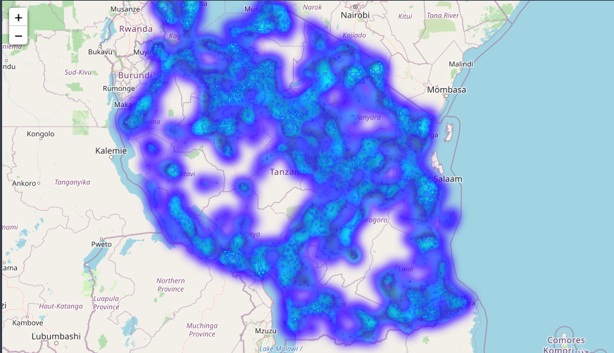
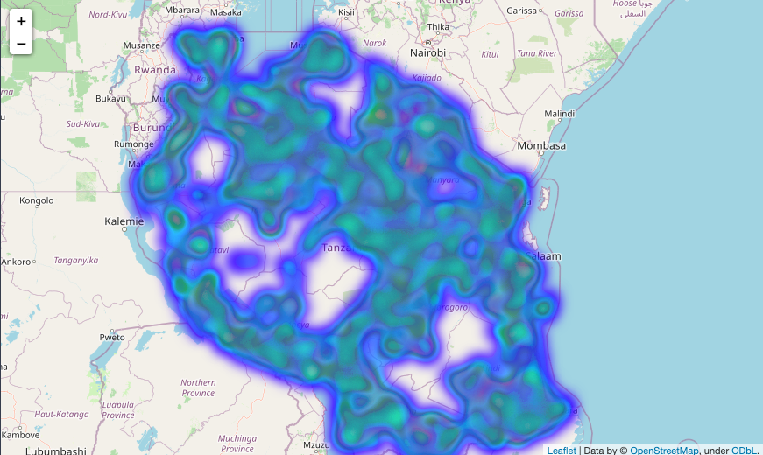
Heatmap of Water Wells
All Wells
Needs Maintenance
Broken wells are evenly dispersed wherever there are wells
Pockets of the country where there are no wells

Slide 12
Key Takeaways (Repair efforts)
Wells start to break down at 18-20 years old
From our heatmaps, wells that need maintenance are dispersed throughout country. Meaning if there was a broken well, there would be a functional one nearby (3-5 miles).
Construction efforts include pinpointing broken wells (accuracy metric) XGBoost w/ GridSearch is the best model. (.781 Accuracy)
Pockets of the country that have no wells. How are they getting water?

